Slide 1
On EXECUTIVE SUMMARIES AND ABSTRACTS
Nicoletta Di Blas - Introduction

Slide 2
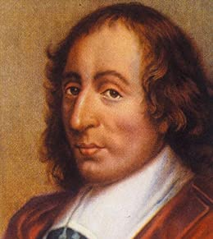
I'm sorry I sent you such a long letter. I didn't have time to write you a shorter one
(B. Pascal)

Slide 3
Executive summary and Abstract
Both are quite condensed texts “summing up” a longer text. But there are differences:
An abstract is a brief summary of a document, such as a journal article, a conference paper, a book proposal. It is usually 100-300 words long
An executive summary is a summary of a longer document; max length: 10% of the document

Slide 4
Both should be:
SHORT
CLEAR (of course)
COMPREHENSIVE (sketch the whole picture)
the context
the goal of the work (AND its relevance!)
[the method – if there is room]
the main results
EFFECTIVE: convey the key-message(s) and values
SELF-SUFFICIENT: never ever «point» to the main document; and yes, you can copy and paste from the main document

Slide 5
“This project addresses the issue of ageing population in Europe.” (ISSUE)
“The overall aim of the project is to prevent Mild Cognitive Impairment and Frailty.” (AIM)
“…by unobtrusive detection of data through sensors” (METHOD)
“… and exploiting data that smart cities are already collecting”. (METHOD – and KEY MESSAGE!)
“Detecting mild cognitive impairment and frailty will be partially automated, thus making the monitoring of the elderly population much more efficient and the prevention of frailty more effective” (BENEFIT)
Sketching a summary…

Slide 6
How should it NOT be?
An introduction
An appetizer without the main course: “This is thesis is about conversational agents for people suffering from autism, which is a disease… bla bla… and… NOTHING ABOUT WHAT HAS BEEN DONE”
A table of content
A skeleton without meat: “In the document we will discuss… then the method is introduced… then we will present the results...”

Slide 7
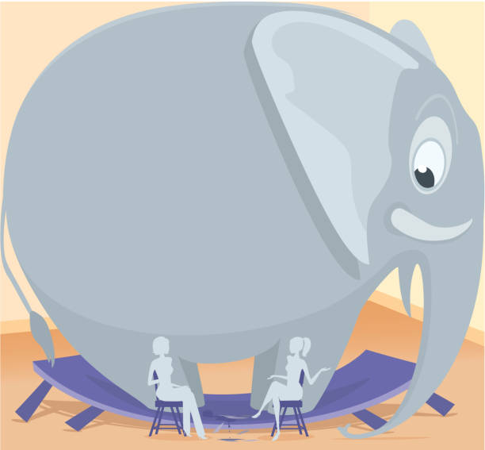

Slide 8
Notes on chatGPT & friends
Powerful helpers, not substitutes
Large Language Models tend to:
be generic
be repetitive
use sophisticated style
You as author have to “take the lead”:
Decide what the key messages are
Decide what the flavor is (is this thing I’m introducing: positive, negative, innovative, despicable…)
What style you want
What elements of information should be there
Tips:
Use LLM to refine the style (prompts can help you get something more formal vs. something more simple)
Use LLM to create emphasis (on what YOU decide deserves it)
Work on small chunks of text rather than on whole documents

Slide 9
END

